Slide 1


Enabling Locality Outcomes
Prof Paul Cameron
Head of Community Health and Care
paul.cameron2@nhs.scot

Slide 2

Enabling Locality Outcomes
Suite of Support
Choice and control
Working together
Assessed Need and Identified Outcomes

Slide 3
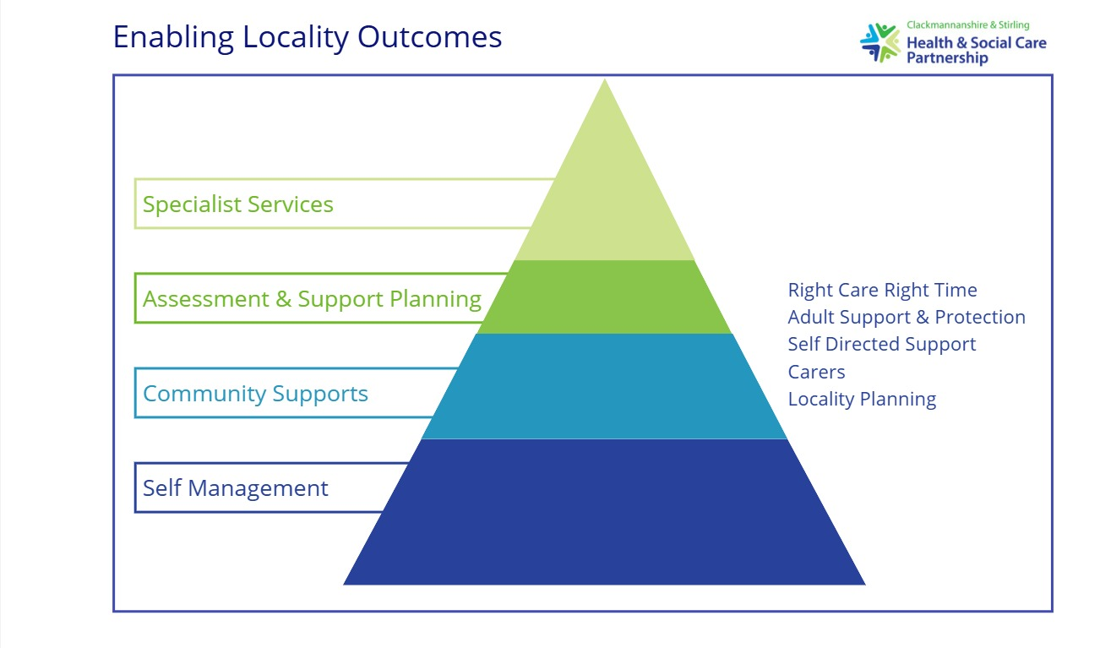
Digital Supports
CSHSCP Website
AskSARA
Mobilise
Online Directories

Slide 4
Digital Supports
Michelle Duncan
Planning & Policy Development Manager
duncanmi@stirling.gov.uk

Slide 5
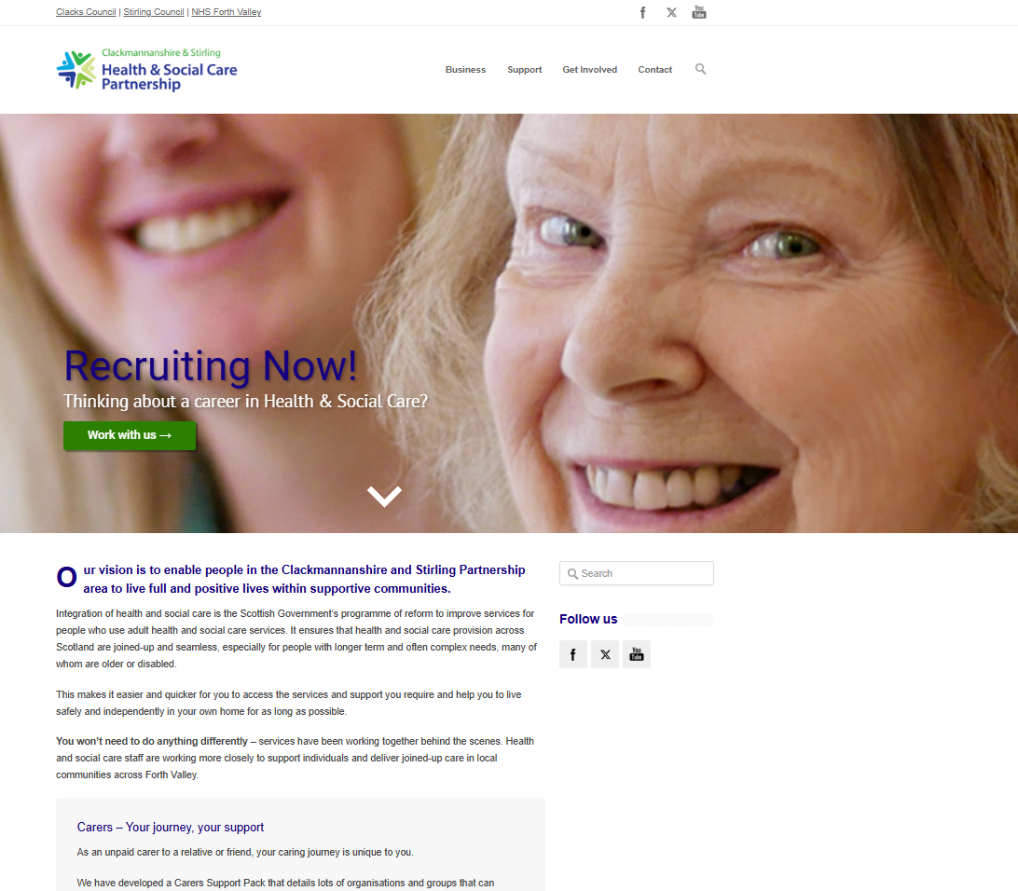
CSHSCP Website
Source of good information
Focus on people and their need
Focus on self-management
Links to community and peer support
Council & NHS Website will link to CSHSCP
The Equality A

Slide 6
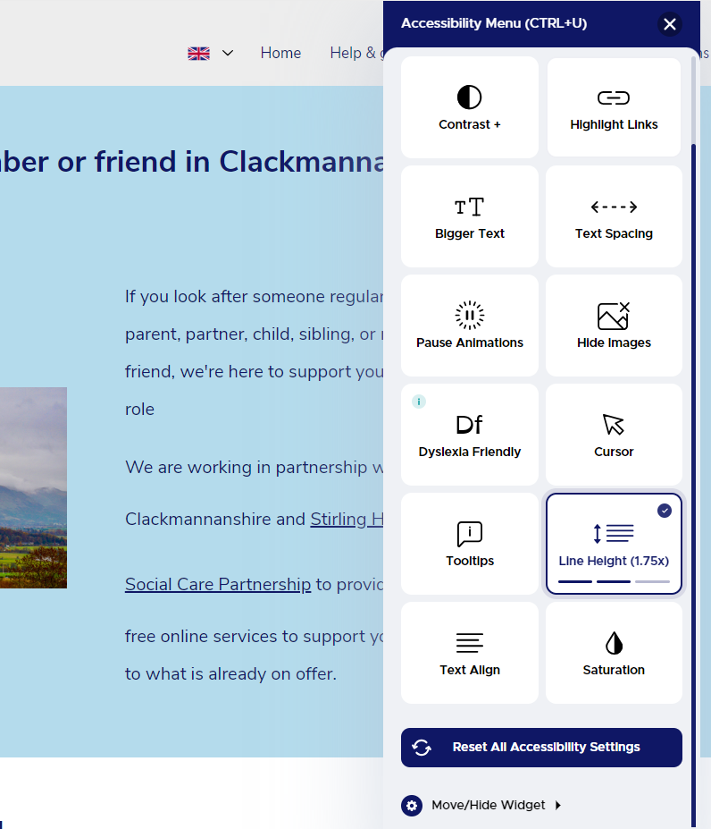
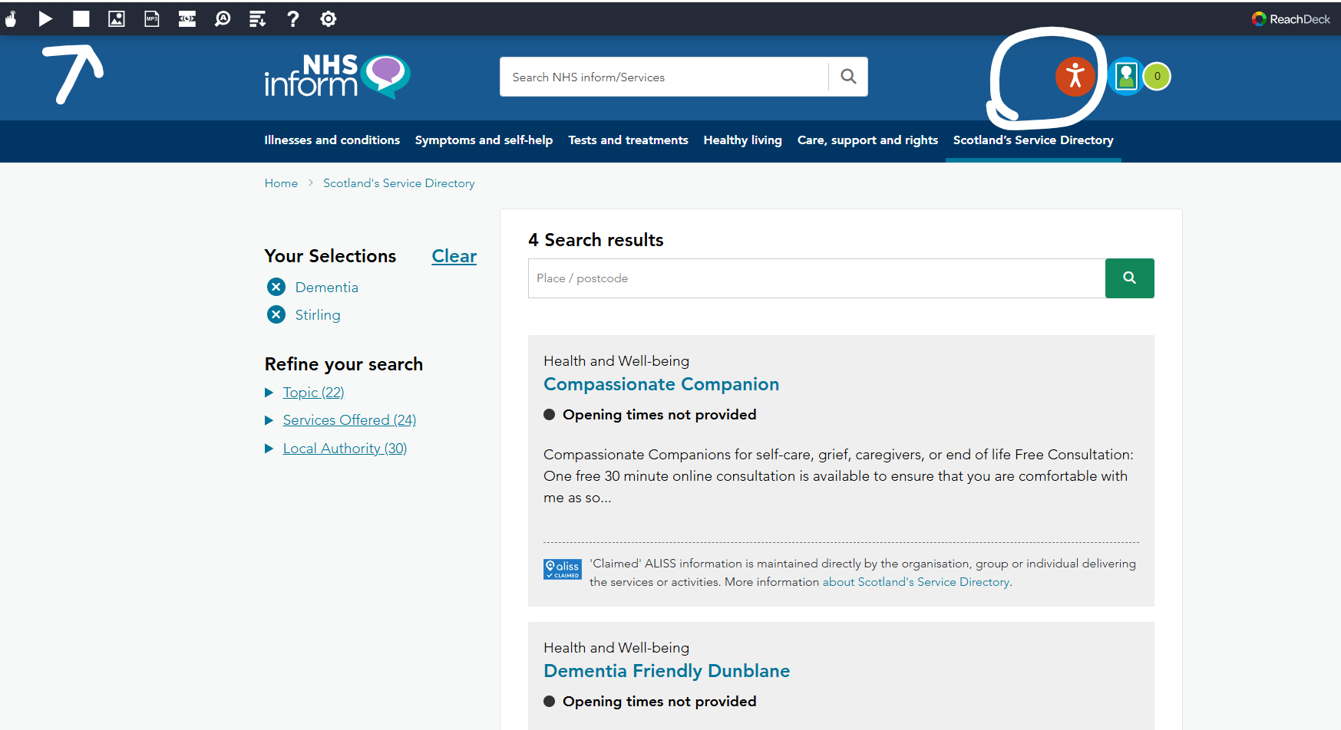
Accessibility
Notes:
More and more websites have accessibility toolbars to assist people accessing website.
These can help change font size and shape, readers, summaries and colours/contrast.
Again, digital tools are part of the range of supports available to people. They won’t be right for everyone, but you can pick and choose the options right for you.

Slide 7
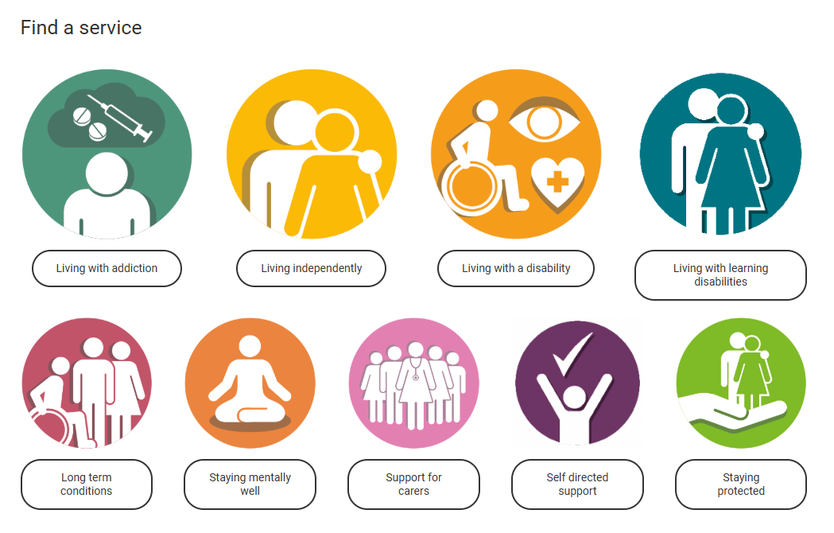
Website Workshop – what does good information look like?
Who do we need a page for?
What should be on that page?
Who should we signpost to on that page?

Slide 8

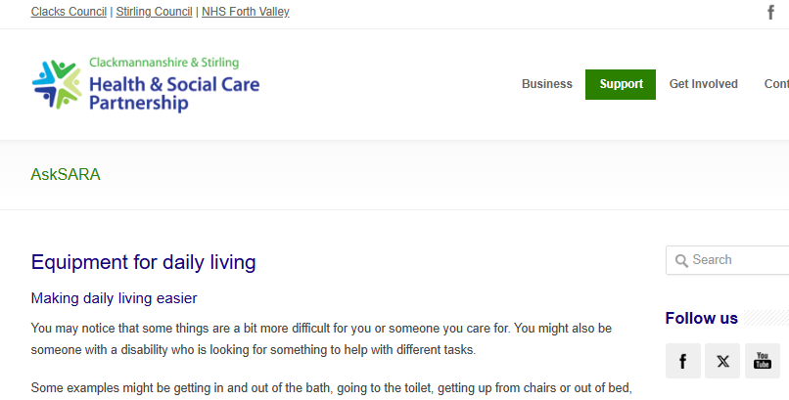
AskSARA
Online guided advice tool to help with daily activities
Over 90 topics to choose from
Generates personalised report with recommendations and links to equipment
Can support people at home for longer, without need for services
https://cshscpasksara.livingmadeeasy.org.uk/
The Equality A
Notes:
Please follow the link in the slide for AskSARA
Highlights
Number of topics
Practical advice and tips as well as recommendations for equipment to help with daily activities
Links to equipment and suppliers (vetted)
Links to both Carers Centres and SDS Forth Valley on results page
Links to other local third sector organisations for the topic on results page

Slide 9
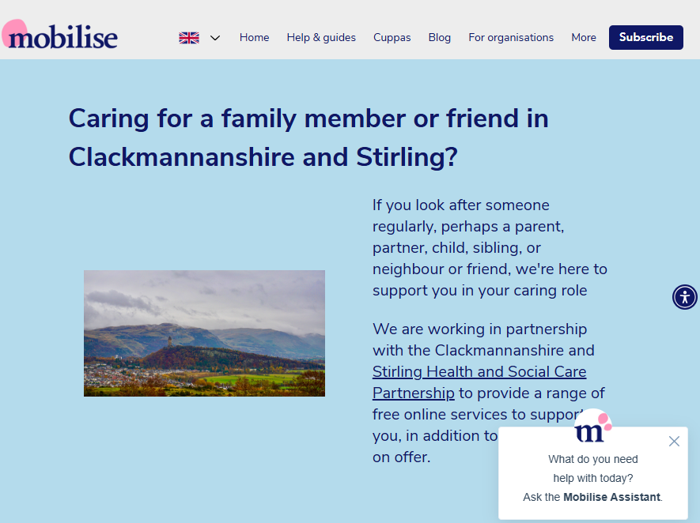
Mobilise
Online support for unpaid carers
Access any time, any place
Mobilise Assistant
Help and Guides
Virtual Cuppas to meet with other carers
Telephone support in weekends and evenings
Blog with personal stories, practical tips and wellbeing tips, Carer’s Hacks
https://support.mobiliseonline.co.uk/clackmannanshire-and-stirling
Notes:
Please follow the link in the slide and take a look around Mobilise and what it has to offer.

Slide 10
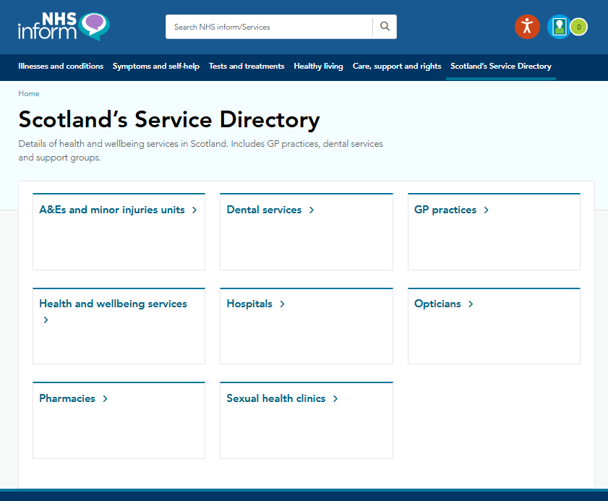
Scotland’s Service Directory
Part of NHS Inform
Health and Wellbeing Services
Clacks 192 organisations and groups
Stirling 213 organisation and groups
Can select by geography, topic
https://www.nhsinform.scot/scotlands-service-directory/
Notes:
Please follow the link and get to know your way around the Directory.
Save to your favourites, that way you’ll be able to access it quickly.

Slide 11
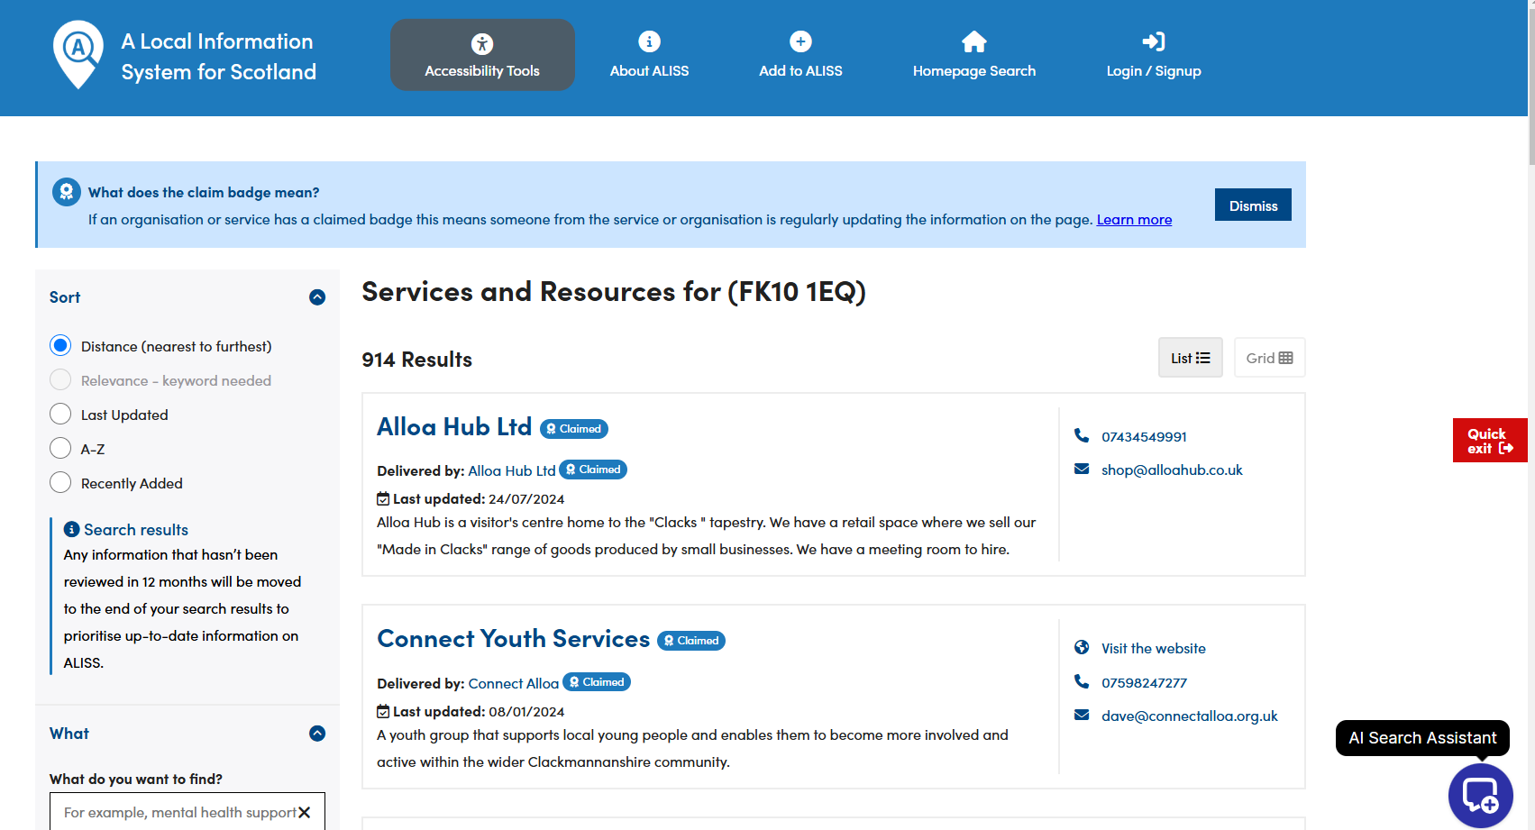
ALISS A local information system for Scotland
Feeds into Scotland’s Service Directory
Much more organisations
869 in Clackmannanshire
917 in Stirling
Select geography, category or search
https://www.aliss.org/
Notes:
Please follow the link and get to know your way around ALISS.
Save to your favourites, that way you’ll be able to access it quickly.

Slide 12
Revised approach to Self-Directed Support
Emma Mitchell
Self-Directed Support Lead
mitchelle@stirling.gov.uk

Slide 13




Have the information available but no access to the people on the waiting list
Are aware of who is on the waiting list but no capacity to provide information until a frontline practitioner is allocated

Slide 14
Well Worthwhile Waiting Project
General information - not specific to the individual
Expectation management – this is an asset based approach
Enables supported people to feel better prepared and informed prior to assessment
Supported people and carers can
As workers we can focus on the outcomes and needs
Aligning with Self-directed Support Framework of Standards

Slide 15
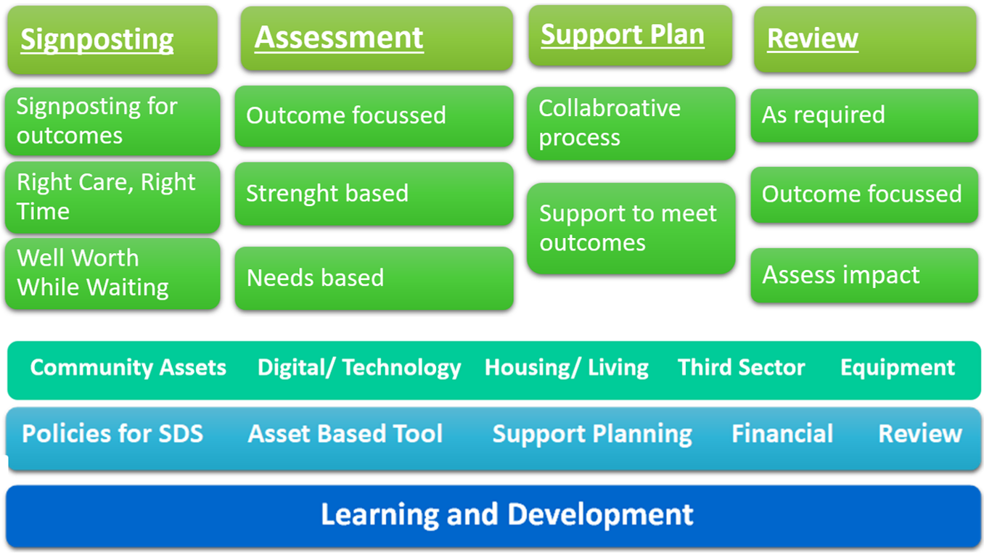
SDS Plan on the page

Slide 16
Work in progress…
Assessment documentation
Support plan documentation
Review documentation
Standard Operating Procedures
Information for the public on SDS
Well Worthwhile Waiting
Staff Briefings/Training
Engagement SDS Stakeholder Participation Group
Links with Self-directed Support Project Team, Community of Practice and SDS network
Reopening Independent Living Fund

Slide 17
Assessment
Supports ‘good conversations’
Assets/strengths based
One assessment tool that can be used across the HSCP
Person centred
Outcome focused
Equivalency model

Slide 18
Development session
What are your thoughts on the proposed assessment tool?
The assessment tool is subject to further testing, with that in mind, what do you want to be covered as part of any future testing?
The assessment guide is being developed. What information do you think needs to be incorporated into the guide?
What do you feel needs to be in place to support you and your colleagues in using the new documentation/revised approach?
Any other feedback/suggestions

Slide 19
Close
text

