Slide 1

Right Care Right Time Programme
Maxine Ward – Head of Community Health & Care
Terry O’Gorman – Locality Manager
David Niven – Adult Social Care Portfolio Lead
Community Health & Care Workforce Events – 23/24 Jan2024 2023

Slide 2

Overview of Presentation:
Background and Aims
What Initial Data tells us
Future Model
Programme Management Approach and Projects within it
Plan – Timeline
Detailed Look at the Future Model
Break
Group Discussion
Brief Feedback and What Next?

Slide 3

Background and Aims
The Right Care Right Time Programme builds upon the recommendations of the David Welsh report from his Review of Adult Assessment & Review Processes in 2021 as well as other good practice identified in the period since.
The Problem as we understand it today:
a) Multiple bottle necks in current adult social work processes
b) Many people on pending lists
c) Over provision of care and lack of timely reviews
d) Difficulty in focussing on prevention and early intervention, and long term relationship work
The Right Care Right Time Programme aims to achieve the following outcomes:
  Improve Service User Experience by creating more efficient processes that reduce reliance on pending lists
  Reduce the Costs of Care, where possible, by providing the right care at the right time with regular reviews and signposting for outcomes
  Support Workforce Wellbeing through the development of clear, efficient and easy to use processes

Slide 4
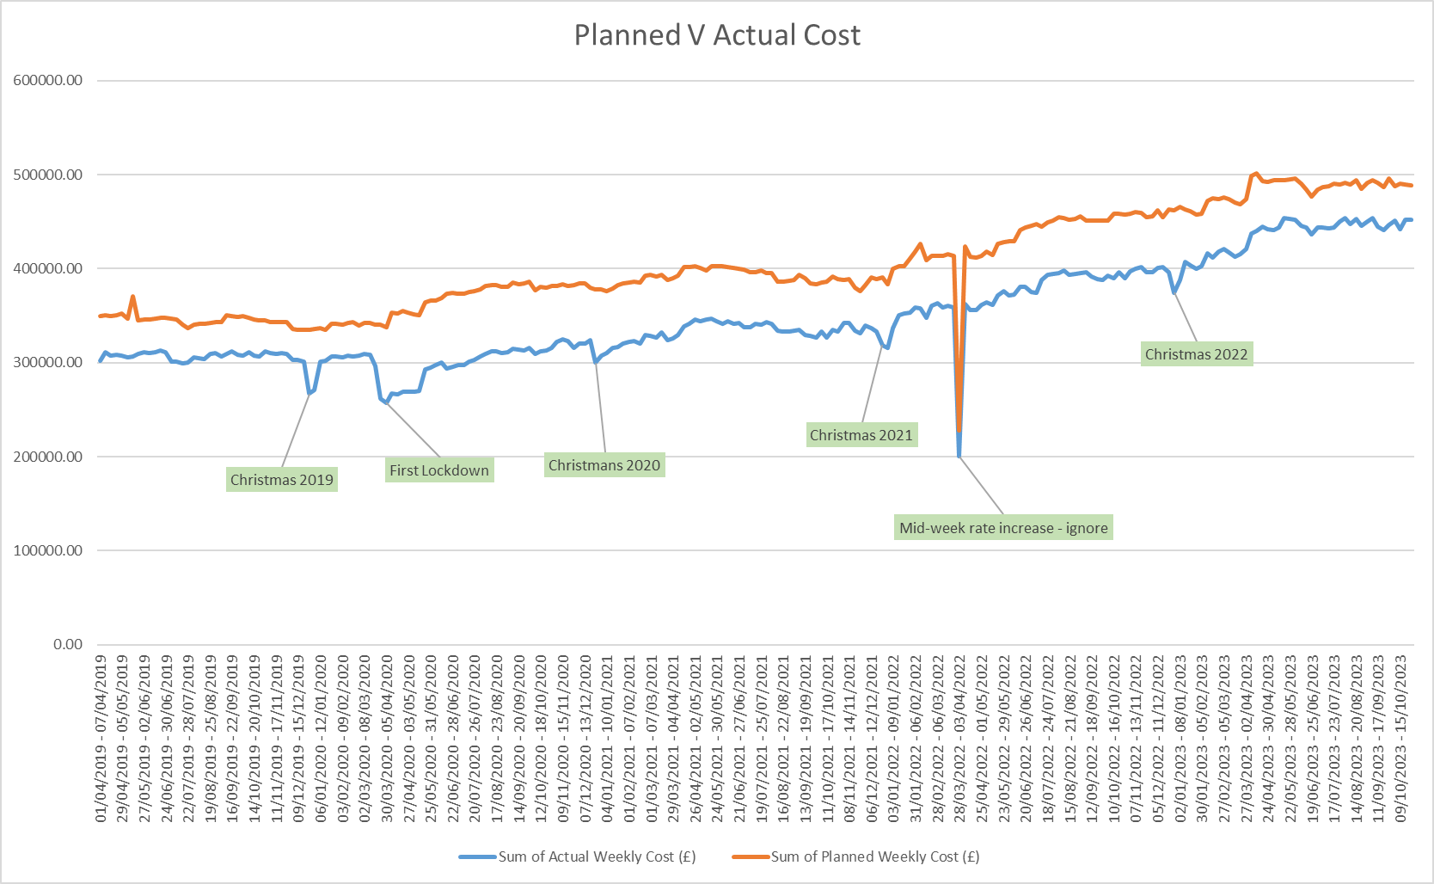
What Initial Data tells us:
Notes:
The Data presented in this section is for Stirling only at present but we are working on getting similar trend data for Clacks.
The graph above shows the planned and actual costs for all Care and Support (Care at Home/Day Care/Sleepover/Waking Nights) in Stirling.
This data shows: 1) Blue Line (Actual costs) are approx. £300k per week in 2019 and £450k in 2023. This is a 50% increase from 2019 to 2023

Slide 5
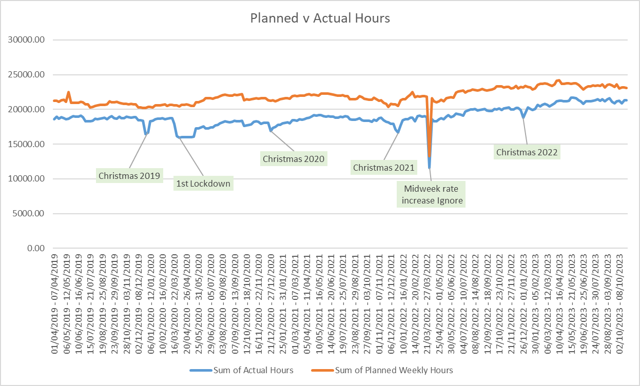
What Initial Data tells us:
Notes:
This is the planned (red) and actual (blue) hours for all Care and Support (Care at Home/Day Care/Sleepover/Waking Nights) in Stirling Only.
This data shows: 1) Blue Line (Actual hours) are approx. 18,700 per week in 2019 and 20,900 in 2023. This is a 12% increase from 2019 to 2023.
When population growth trend is taken into consideration it looks like there is approximately a 10% increase in all Care and Support hours from 2019 to 2023.
The difference between 50% increase in costs and 10% increase in hours is to do with increasing costs of care including increased pay rates for carers and the overall market for care.

Slide 6
Notes:
This shows a snap shot from April 23 of the Total Number of Community Care Referrals Pending across all of the Community Care teams in Stirling. We are working on an updated version of this data but we expect more recent figures to be similar with approx. 1000 referrals pending in Stirling.
While we haven’t got this information in graphical form on 11 Dec 23 there were 452 referrals pending in Clacks.
Comprehensive (OT or SW cases) - 248
Standard (SCO only) - 116
Stairlift Reviews (OT only) - 43
Carer Reviews - 45

Slide 7
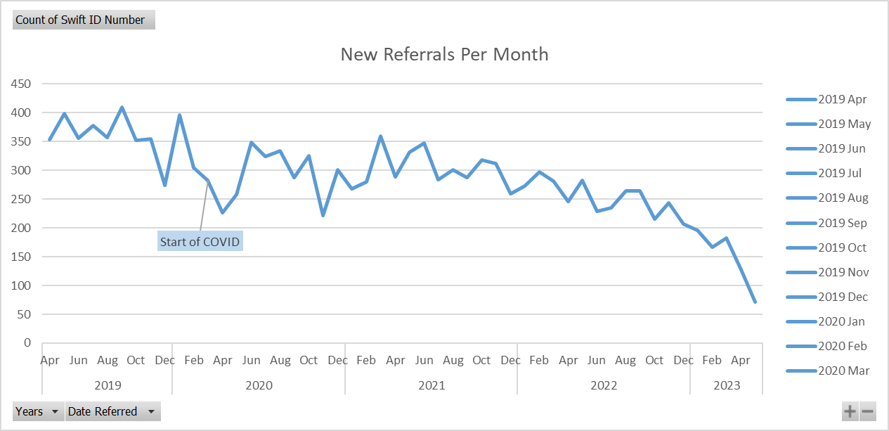
Notes:
This slide shows the number of NEW referrals per month for all of Community Care (including LD & MH) in Stirling.
The drop off in numbers in later 2022 and 2023 may reflect a change in recording practice. We should assume that the long term average of circa 300 new referrals is relevant to the RCRT Programme.
We are working on identifying comparable date for Clacks.

Slide 8
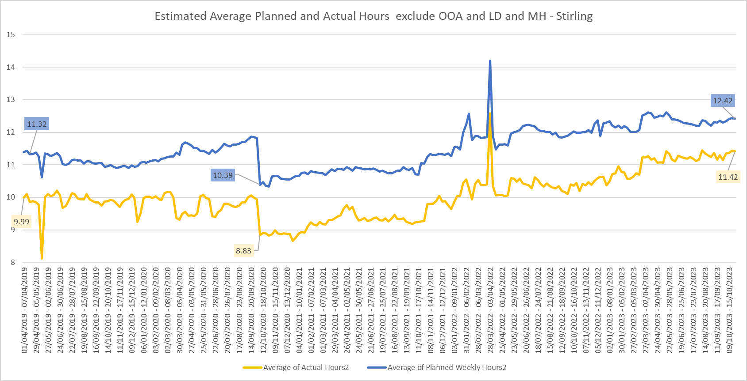
Notes:
This graph shows the average weekly planned and actual hours of care provided to core ‘Older Adult and Physical Disability’ service users (with most LD and MH service users removed) in Stirling from April 2019 to October 2023.
The yellow line is average actual hours of care per week and it shows that approx. 9.9 hours of care per person per week was supplied to a weekly average of 929 people during 2019 while over 11.1 hours o care per person per week was supplied to a weekly average of 868 people during 2023.
This aligns with the first two data slides shown above which estimate that there has been a 12% increase in care overall.
As mentioned previously further work is required to provide a similar analysis of the situation in Clackmannanshire.
Further Data analysis is also required across the LTC and STC bed use in both Clacks and Stirling as the other major area where Demand Management is likely to drive this work.

Slide 9
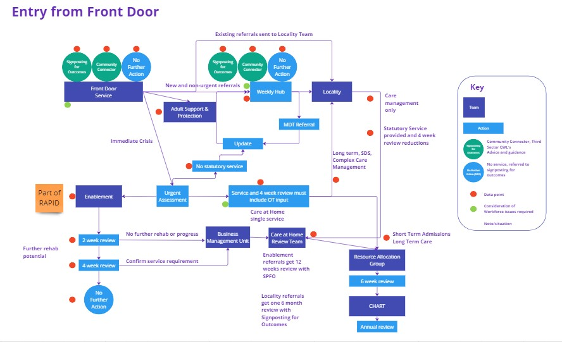
DRAFT Future Model – Adult Social Care Front Door Process:
Notes:
Key points with this model include:
The model aims to deal with all incoming new referrals on a daily and weekly basis with no pending lists as the long term objective
The establishment of data collection and monitoring at all of the red nodes on the above process diagram – HSCP Data colleagues are working on establishing baseline information and methods to record it.
A dependant project sitting within the HSCP Strategic Planning & Health Improvement section is the development of a ‘Signposting for Outcomes’ approach with third and community sector. This will maximise early and preventative access to, and use of, community opportunities that support people to maintain their independence.
Initial conversations about this diagram have identified there is a potential improvement where there is an additional link from urgent service into the weekly or a virtual hub to put in place alternatives to STC such as overnight care at home to avoid a STC admission and the associated risk of deconditioning and extended duration of stay due to lack of review or formal assessment.
Planning work will be carried out in Jan/Feb 24 with the aim of preparing the Front Door and Locality teams in both Clacks and Stirling to be able to make the transition to their version of this new process
During Jan 24 SOPs will be drafted up for each of the stages in the Front Door process and their interface with Reablement. Localities, and Urgent responses such as STC.

Slide 10
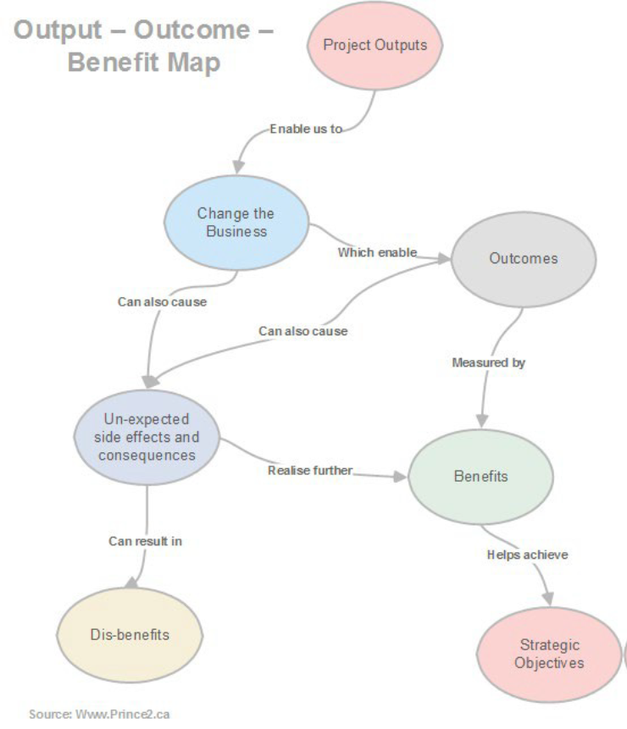
Programme Management Approach and Projects within it:
A Programme Management approach is used to deliver outcomes and benefits through the management of a suite of interconnected projects in a flexible and responsive manner. It focusses on aligning with strategic objectives, managing interdependencies, optimising resource use to maximise impact, and the active management of risk and change.
Stakeholder Engagement and Communications are crucial to an effective programme management approach. Meetings such as this are important components of early stage programme development and refinement and your feedback and ideas are really welcome.

Slide 11
Programme Management Approach and Projects within it:
Right Care Right Time Programme – Projects and Dependencies
Programme Level Stakeholder Mapping, Engagement, & Communication
Refine the Adult Social Care Front Door Process Map and develop SOPs including at the interface with Reablement, Localities, and Urgent responses such as STC and ASP.
Deliver the Care At Home Review Team Project
Complete the establishment of the Rapid Team Project
Develop HSCP Adult Social Care Front Door Website Information including Ask Sara
Review existing Adult Social Care Operational Teams and identify reforms that enable the smoothest transition to deliver the new Process Model
Deliver Programme Outcomes
Develop ‘Signposting for Outcomes’ resources, contact points and connectors to increase easy early access to Community Supports
Realise Programme Benefits
Identify, develop, and deliver any additional Projects needed to deliver Prog. Outcomes

Slide 12

Plan – Indicative Timeline:
Agreed way forward documented in both Clacks & Stirling
Phased shift to new Adult Social Care Front Door Process, SOPs, & Team Structure in both Clacks and Stirling
HSCP Operational Team Leaders Meeting
Right Care Right Time – Data Sub Group
Right Care Right Time – Wider Workforce Event Alloa
Ludgate House, Alloa
Mon 18 Dec 23
Mon 08 Jan 24
Tues 23 Jan 24
End Feb 24
W/C 11 Dec 2023
W/C 08 Jan 2024
W/C 05 Feb 2024
W/C 04 Mar 2024
During Mar 24
December ‘23
January ‘24
February ‘24
March ‘24
Signposting for Outcomes Project Group
Right Care Right Time Programme Board
Right Care Right Time – Wider Workforce Event Stirling
Updated Process, SOPs, & Team Structure document ready for staff feedback in Clacks & Stirling
Support Staff, Manage Change, Monitor Data, Realise Impact
Tues 19 Dec 23
Tues 16 Jan 24
Weds 24 Jan 24
Mid/Later Feb 24
Mar 24 Onwards

Slide 13


Slide 14
Questions & Discussion:
  Questions for you:
  What are the Good Bits about this proposal?
  Does this proposal give you any Worries or do you perceive any Risks?
  Do you have any Suggestions about how to improve this proposal?
  Have you any Questions for us?

Slide 15
Feedback and What Next?:
  Brief feedback from group discussions
  Any further questions
  Request for volunteers to help develop the SOPs and take part in Front Door Service technical groups
  Citizen Space survey
  Write up of the two events and discussions will be shared over the next few weeks
  Thank-you for making the time to participate today

